Slide 1
SMART VIDEO SURVEILLANCE SYSTEM AND IMAGE CAPTURING USING ANDROID DEVICE WITH GCM ALERT

Slide 2
ABSTRACT
Video surveillance systems.
Mobile robots are an attractive option.
The movement of the people is tracked using video surveillance.
The moving object is identified using the Cauchy distribution model.

Slide 3
Abstract(cont..)
The Cauchy distribution model will compare the current frame with the previous frame.
Using threshold value the detected pixel is identified accurately.
GCM alert send to the android mobile application.
Ability to minimize both false and missed detection.

Slide 4
EXISTING SYSTEM
Only use absolute difference & background model .
Image can be stored in local server.
Moreover there is no alert system to inform the admin.
Image Retrieval from the remote place is not done in the existing system.

Slide 5
DISADVANTAGES
There is no accuracy in the captured image.
The moving object cannot be detected correctly.
SMS alert about the motion detection to the user.
Image cannot be retrieve at the time of motion detection.

Slide 6
PROPOSED SYSTEM
Cauchy distribution model is used.
The pervious frame is compared with the current frame. Here we can detect the exact image of the moving object.
Then the system will alert the user automatically by sending an GCM alert to user’s mobile application.
Android Mobile is used for the Retrieval of Images from the remote place.

Slide 7
ADVANTAGES
High accuracy in motion detection and capturing the image.
Send an GCM alert to user’s mobile whenever a new object is detected
Image can be stored in the server and can be view at the time of motion detection
User can view the image, via his Android mobile itself.

Slide 8
LITERATURE SURVEY
A Real Time System for Detecting & Tracking People(IEEE)
-Pixel classification
Handover Location Accuracy for Travel Time Estimation in GSM & GCM(IEEE)
- Minimize the alert time
Multi-Layer Background Based on Color and Texture(IEEE)
-Uses LBP( Gray scale invariant texture )
Adaptive Background mixture models for real-time tracking(IEEE)
-Shadow detection

Slide 9
SYSTEM SPECIFICATION
Software Requirements:
Operating system : Windows XP
Technology Used : Android 2.2
IDE : Eclipse 3.4 (min)
Emulators : AVD
Plug-in : ADT plug-in
Tools used : Android SDK.

Slide 10
SYSTEM REQUIREMENTS
Hardware Requirements
Processor : Pentium P4
Motherboard : Genuine Intel
RAM : Min 1 GB
Hard Disk : 80 GB

Slide 11
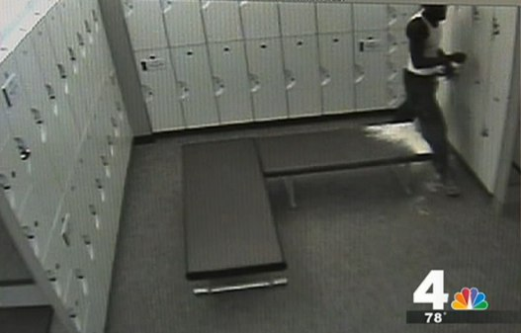
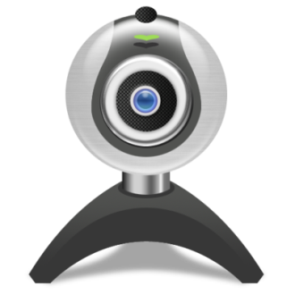
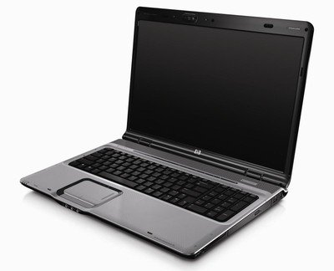
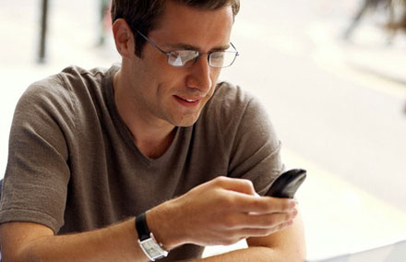
SYSTEM ARCHITECTURE
Captured image is
Compared with
Reference image
If abnormal pixel
is detected save image
in server
Surveillance camera
for motion
detection
Send GCM alert
to User
User can view
the detected image
in his mobile itself.

Slide 12
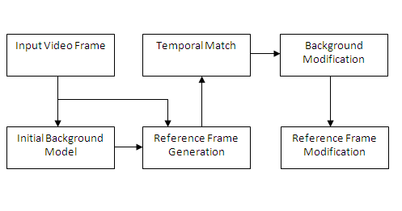
DATAFLOW DIAGRAM

Slide 13
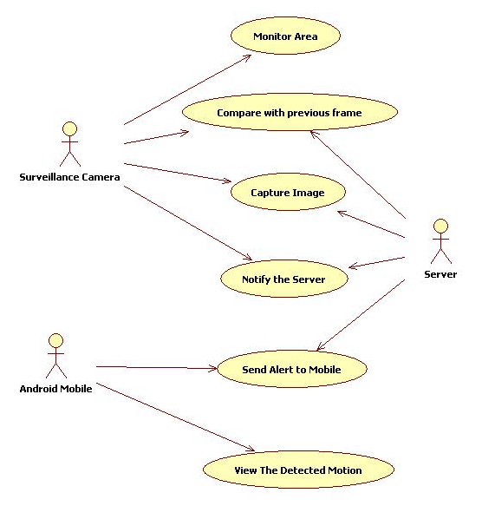
UML Diagrams Usecase Diagram

Slide 14
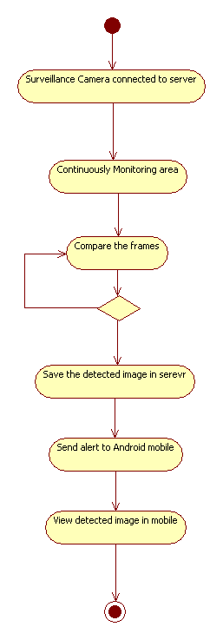
Activity Diagram

Slide 15
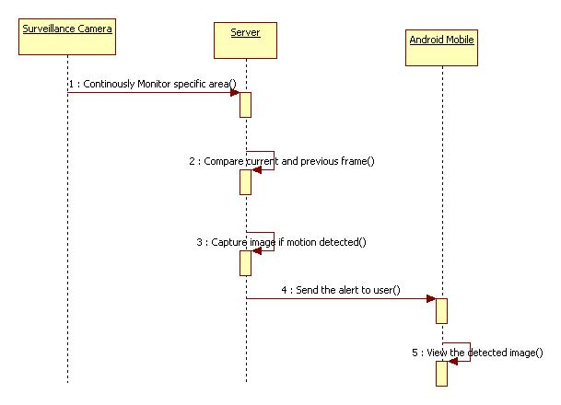
Sequence Diagram

Slide 16
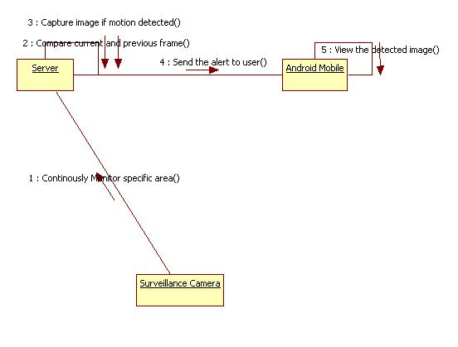
Collaboration Diagram

Slide 17
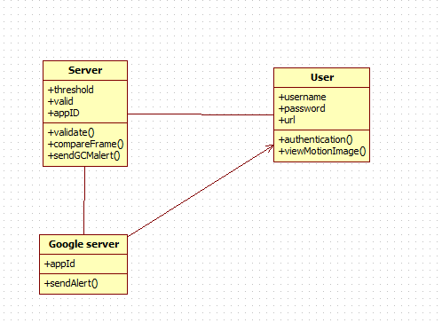
Class Diagram

Slide 18
MODULE SPECIFICATION
User Authentication For Application
Detecting Image using Cauchy distribution Model
Sending GCM Alert
Viewing the Detected Image

Slide 19
User Authentication For Application
User authentication is a means of identifying the user and verifying that the user is allowed to access some restricted service
The main aim of this modules is to authenticate the user to application to view the motion detected image
This modules include username and password for authentication to application
The validation is based on web service in server

Slide 20
Detecting Image using Cauchy distribution Model
Detect the motion in the particular area.
Detection is done using Cauchy distribution model and Absolute Differential Estimation .
Absolute Differential Estimation is used to compare the background frame and incoming video frame if any changes occur in incoming video frame .
Cauchy distribution Model is used to detect the pixel of moving object in the detected incoming video frame.

Slide 21
Sending GCM Alert
Whenever motion detected that image is saved on the server and the server will notify the google server.
The google server will send an GCM Alert to the android application.
GCM is a service that allows you to send data from your server to your user’s Android-powered device.
This could be a lightweight message telling your app there is new data to be fetched from the server

Slide 22
Viewing the Detected Image
Android application will receive the notification(GCM) based on project id which is registered in Google account.
Application id will unique for each application.
After receiving the GCM alert from the server to the application and the user needs to authenticate for the application .
The image can be viewed using the url which is received from the GCM alert.

Slide 23
CAUCHY DISTRIBUTION METHOD
It is closely related to the Poisson process, which is the fundamental solution for the Laplace equation in the upper half-plane.
This algorithm is used to find the difference between current frame with previous frame.
It converts RGB into Black&White image.
Then converted image is splitted in to 64x64 matrix and compare each and every matrix value in the frame.

Slide 24
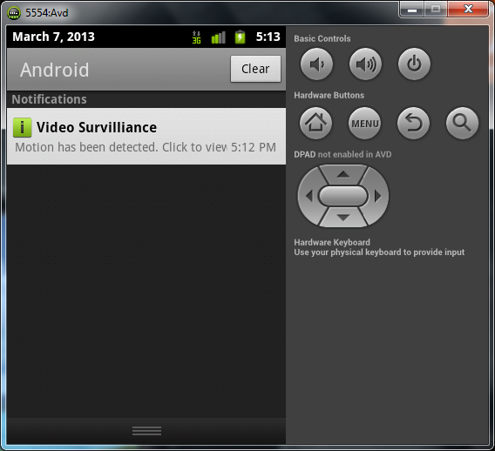
Output Screen shots

Slide 25
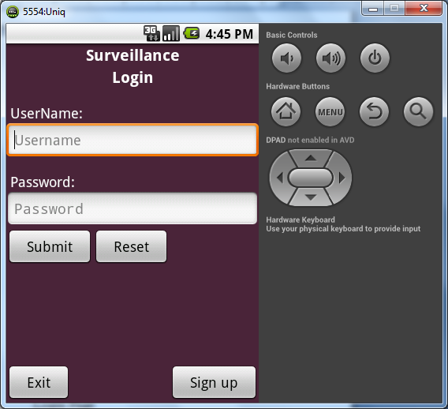
Cont..

Slide 26
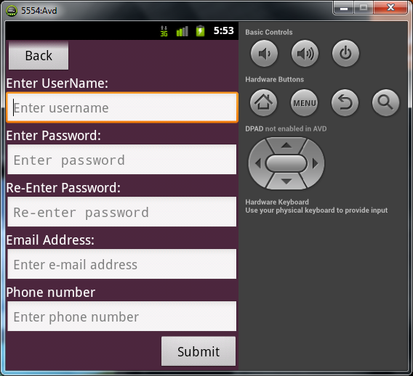
Cont..

Slide 27
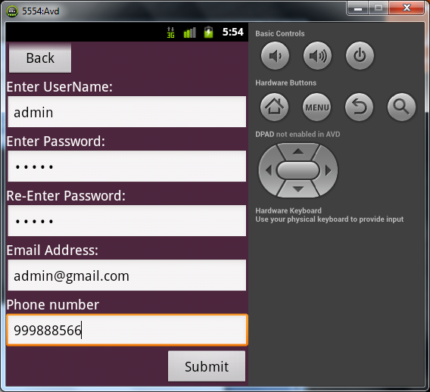
Cont..

Slide 28
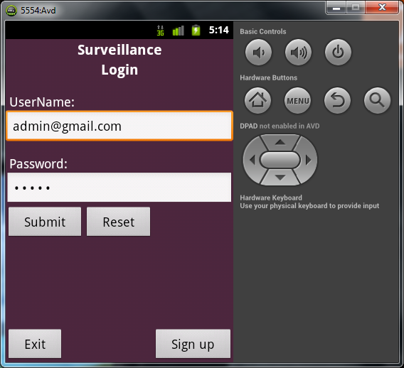
Cont..

Slide 29
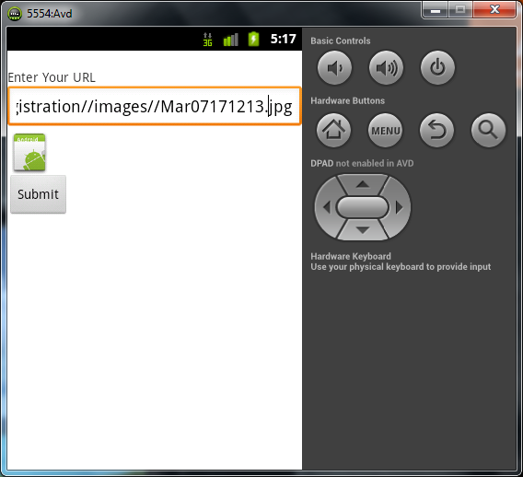
Cont..

Slide 30
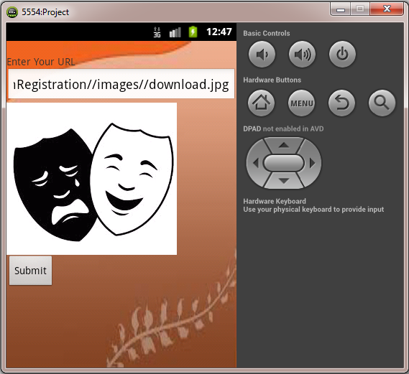
Cont..

Slide 31
Motion Detection
public TestMotionDetection() {
boolean waitForState(int state) {
synchronized (waitSync) {
try {
while (p.getState() != state && stateTransitionOK)
waitSync.wait();
} catch (Exception e) {}
}
return stateTransitionOK;
}
}
}

Slide 32
Coding for Broadcast receiver
public void onReceive(Context arg0, Intent arg1) {
if (arg1.equals("com.google.android.c2dm.intent.REGISTRATION")) {
handleRegistration(arg0, arg1);
Log.d("Registration received", "Registration received");}else if (arg1.equals("com.google.android.c2dm.intent.RECEIVE")) {
handleMessage(arg0, arg1);
}}
private void handleMessage(Context arg0, Intent arg1) {
}
private void handleRegistration(Context arg0, Intent arg1) {
String regis_id = arg1.getStringExtra("registration_id");
if (regis_id != null) {
Log.d("Registration Id", " "+regis_id);}
else if (arg1.getStringExtra("error") != null) {
Log.d("Registration Error", ""+arg1.getStringExtra("error"));
}}

Slide 33
Coding for IP Address
public class ServerIPAddress {
static String address = null;
public static String getAddress() {
return address;
}
public static void setAddress(String address) {
ServerIPAddress.address = address;
}
}

Slide 34
REFERENCES
Shih-Chia Huang , “An Advanced Motion Detection Algorithm with Video Quality Analysis for Video Surveillance System ”., IEEE Trans. on Circuits and systems for Video Technology, vol. 21, No.1, January 2011.Android Operating System, http://www.android.com.
H. Schulzrinne, A. Rao and R. Lanphier, “Real Time Streaming Protocol (RTSP)”, RFC 2326, http://www.ietf.org/rfc/rfc2326.t.
I. Estévez-Ayres, P. Basanta-Val, M. García-Valls, J. A. Fisteus and L. Almeida, “QoS-aware Real-Time Composition Algorithms for Service- Based Applications”, IEEE Trans. on Industrial Informatics, vol 5 (3), pp. 278-288, Aug. 2009.
I. Estévez-Ayres, L. Almeida, M. García-Valls and P. Basanta-Val, “An Architecture to Support Dynamic Service Composition in Distributed Real Time Systems”, Proc of the 10th IEEE International Symposium on Object/component/service-oriented Real-time distributed Computing (ISORC), May 2007. Santorini Island, Greece.
OMG, “Data Distribution Service for Real-time systems”. Object Management Group, 1.2 formal/07-01-01 edition, January 2007.

Slide 35
CONCLUSION
This overcomes the traditional Surveying where Human intervention is needed and has to watch keenly for keeping track of the entire system.
With this project we have introduced a unique technique which is a Major advantage to the old system..
This project also has a feature in which it sends an GCM alert at once there is any sort of variation in the captured pixel.
Here usage of Android Smartphone’s is essential, in order to effectively capture the image, so that anytime anywhere you can view the captured image.

Slide 36





By:
Guide:
Ms.A.Sathiyakala Asst.Prof/IT.
Students
K. AnandRaj,
S. Praveen Raj,
S. Muthamizhan.
Final year.
Arunai College Of Engineering.

Slide 37
Thank You !!!

